Slide 1
MicroPython: The Next Steps to World Domination
Steve Holden
CTO, Global Stress Index Limited

Slide 2
Introductions
Started programming in 1968
Computational scientist by training
Engineer at heart, electronics hobbyist
Python user since Python 1.4
Enjoy helping people to learn

Slide 3
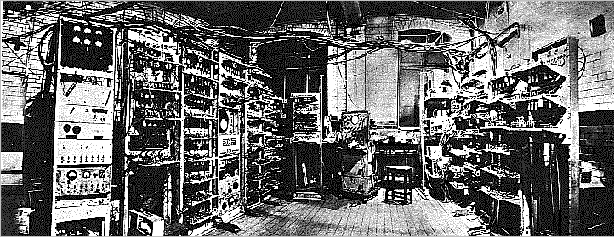
1948
Notes:
1.1KIPS == 0.0011 MMIPS (A thousandth of a MIPS)

Slide 4
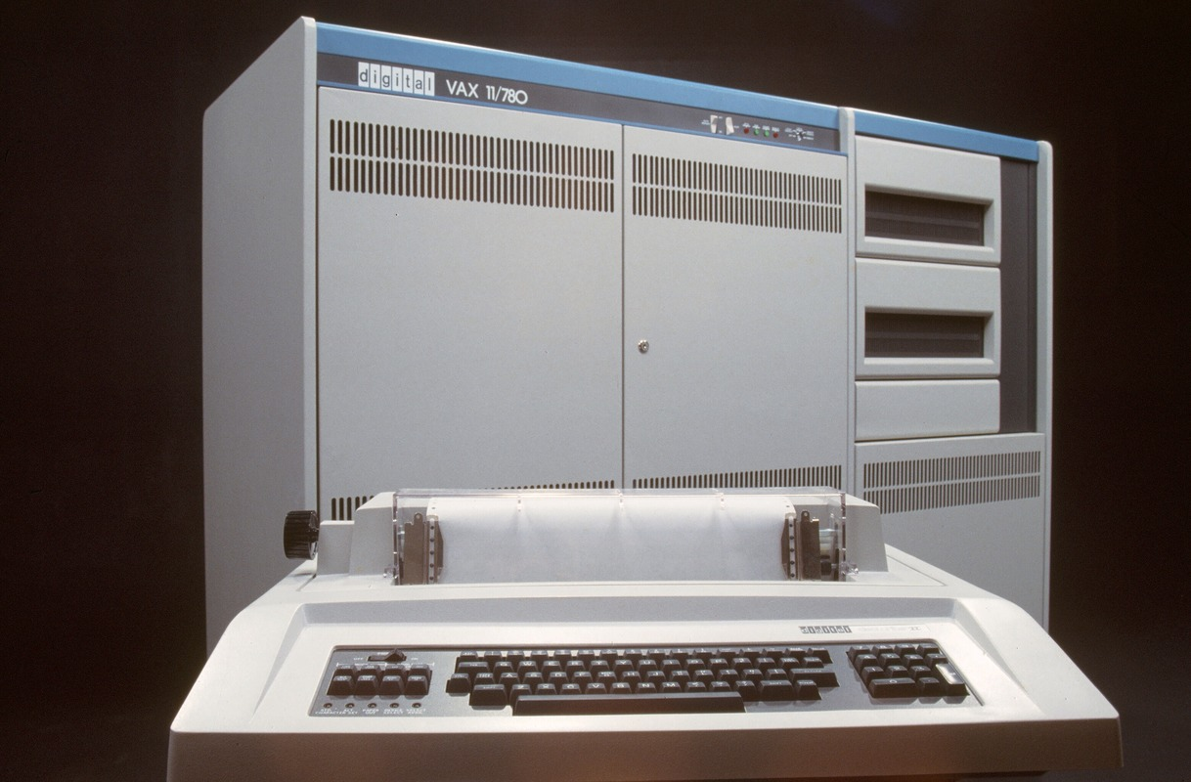
1977
Notes:
VAX 11/780 = 1 MIPS

Slide 5
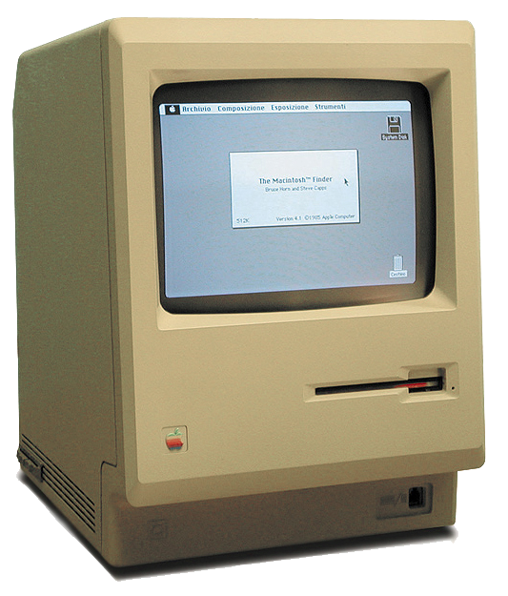
1984
Notes:
0.52 MIPS (36 years)

Slide 6
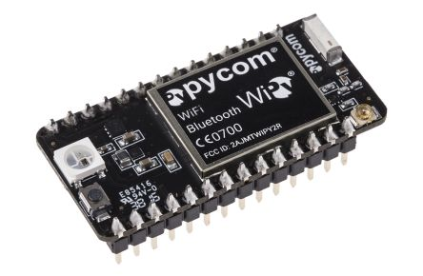
2015

Slide 7
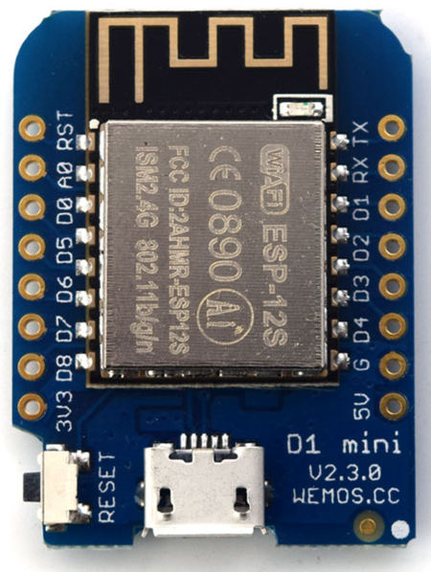
2016
Notes:
200 MIPS!!!!

Slide 8
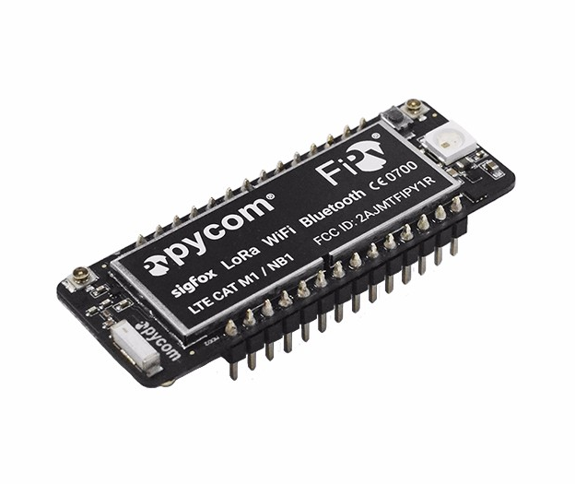
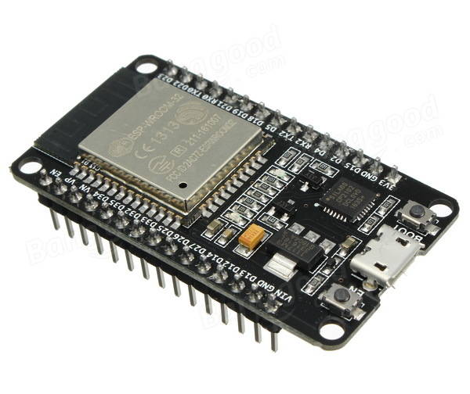
2017
Notes:
FiPy: Five networks: WiFi, Bluetooth, LORA, SigFox, LTE
ESP32: Wifi plus huge resources and 600 DMIPS!

Slide 9
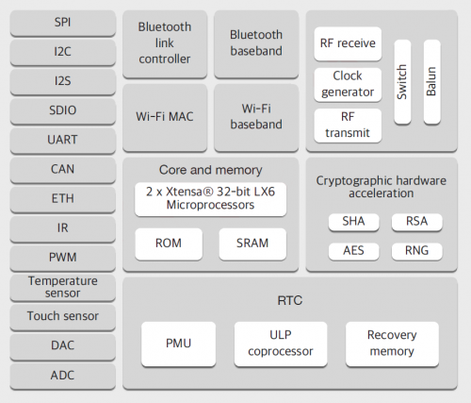
Some ESP32 Features
Twin-core CPU (200 MIPS)
Wifi and Bluetooth
Crypto acceleration
Touch sensing
A-to-D and D-to-A
Many comms interfaces

Slide 10
2020
?
Notes:
Who knows where we are going? These are crazy times!

Slide 11
20-Year Plan for World Domination
Help grow Python’s communities
Help underpin the Python Software Foundation
Profit? (and for whom?)
A million new users in a single year might help…

Slide 12
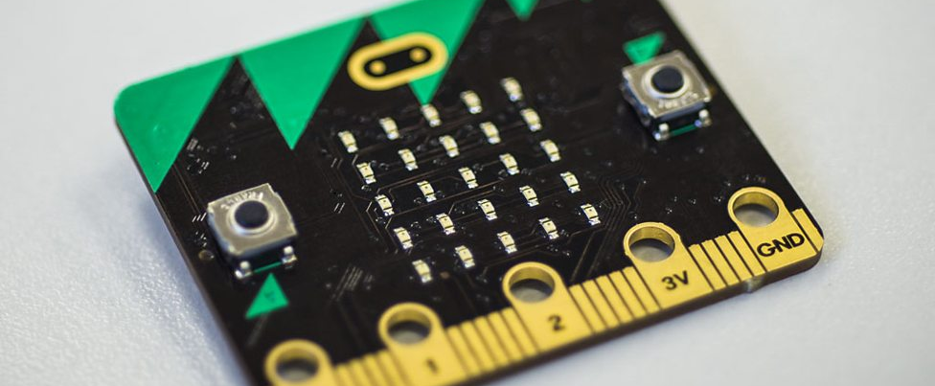
A Seminal Moment: 22.03.2016
Notes:
Date: 22.03.2016 Last updated: 29.03.2016 at 08.12
Category: Make It Digital
In a landmark moment, from today up to one million BBC micro:bits are being delivered free to every year 7 student in England and Wales, year 8 student in Northern Ireland and S1 student in Scotland. The BBC micro:bit, launched as part of the BBC Make it Digital initiative, is a pocket-sized codeable computer that allows young people to get creative with technology, whatever their level of experience, and aims to help develop a new generation of digital pioneers.

Slide 13
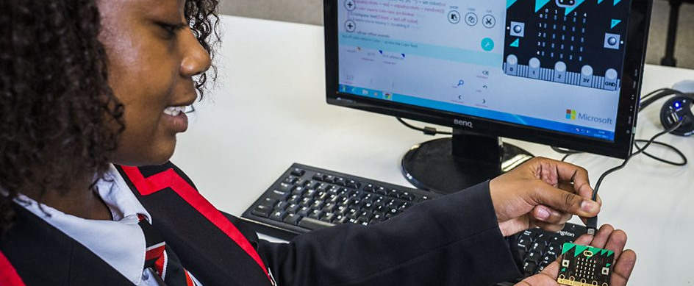
Goal: Python in Everyone’s Reach

Slide 14
Note to Purists
We are talking about learners
They do not need huge libraries
Direct hands-on experience enables
Large resources are not required
Large numbers of devices are

Slide 15
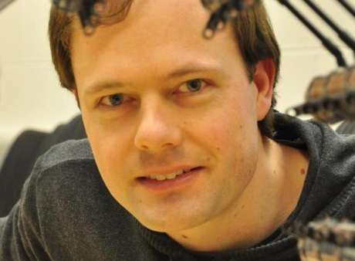

MicroPython
Damien George
Nick Tollervey
Notes:
Damien George, inventor of MicroPyhton
Nick Tollervey, developer of mu

Slide 16
MicroPython Features
The entire Python 3.4 syntax, including
Exceptions
with , yield from, etc.
Also adds 3.5’s async and await
Optional machine code!
Types include str, bytes, bytearray, tuple, list, dict, set, frozenset, array.array, collections.namedtuple
Also, naturally, classes and instances

Slide 17
Supported Systems
PyBoard
WiPy
ESP8266
ESP32
STM32F4
NUCLEO boards
Espruino Pico

Slide 18
Filesystem
A small amount of EPROM appears as /flash
With hardware support you can also get /sd
One or the other becomes current directory
Can access via an abbreviated os module
open works as usual

Slide 19
Boot Sequence
boot.py is run
The USB interface is enabled
main.py is run
Most systems also allow a safe-mode boot
Helpful when you get boot.py wrong
Can reset the filesystem to factory settings

Slide 20
Paste Mode
Enter with ^E
Paste code in
Terminate entry and parse code with ^D

Slide 21
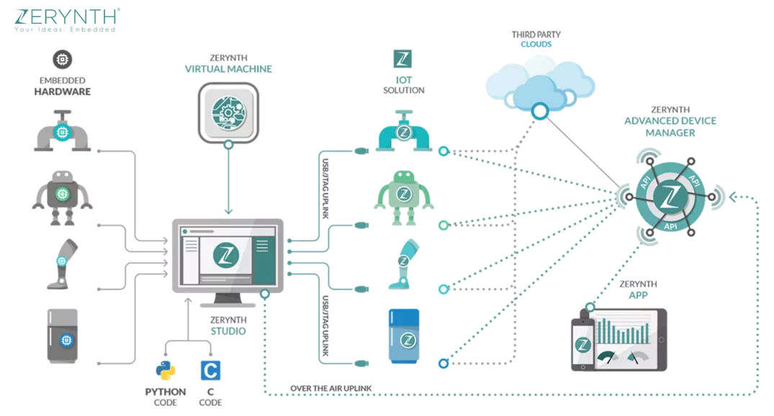
Commercial Support

Slide 22
Zerynth MicroPython Features
Studio: an IDE
VM: real-time ‘OS’ – hardware independent
Advanced Device Manager
OTA updates and remote procedure calls
App: mobile phones to communicate directly with Python-programmed IoT things

Slide 23
Zerynth Supported Systems
ESP8266
ESP32
Microchip/Atmel SAM*
Nordic NRF*
NXP K64
Particle Photon
33 different systems in all!

Slide 24
Digital I/O
from machine import Pin
# Digital input
in_pin = Pin(0, machine.Pin.IN, machine.Pin.PULL_UP)
p = in_pin.value()
# Digital output
out_pin = machine.Pin(0, machine.Pin.OUT)
# Set of clear using the same method
out_pin.value(1) # sets it
Out_pin.value(0) # clears it

Slide 25
File Handling
# Files are stored in a FAT filesystem in flash memory
>>> f = open('data.txt', 'w')
>>> f.write('some data')
9
>>> f.close()
>>> f = open('data.txt')
>>> f.read()
'some data'
>>> f.close()

Slide 26
Simple Networking
def http_get(url):
_, _, host, path = url.split('/', 3)
addr = socket.getaddrinfo(host, 80)[0][-1]
s = socket.socket()
s.connect(addr)
s.send(bytes('GET /%s HTTP/1.0\r\nHost: %s\r\n\r\n' % (path, host), 'utf8'))
while True:
data = s.recv(100)
if data:
print(str(data, 'utf8'), end='')
else:
break
s.close()

Slide 27
Hobby Servomotor Control
import pyb
s1 = pyb.Servo(1) # create a servo object on position X1
s2 = pyb.Servo(2) # create a servo object on position X2
s1.angle(45) # move servo 1 to 45 degrees
s2.angle(0) # move servo 2 to 0 degrees
# move servo1 and servo2 synchronously, taking 1500ms
s1.angle(-60, 1500)
s2.angle(30, 1500)

Slide 28
Interrupt Handling
>>> def callback(p):
... print('pin change', p)
>>> from machine import Pin
>>> p0 = Pin(0, Pin.IN)
>>> p2 = Pin(2, Pin.IN)
>>> p0.irq(trigger=Pin.IRQ_FALLING, handler=callback)
>>> p2.irq(trigger=Pin.IRQ_RISING | Pin.IRQ_FALLING, handler=callback)

Slide 29
Power Control
import machine
# configure RTC.ALARM0 to be able to wake the device
rtc = machine.RTC()
rtc.irq(trigger=rtc.ALARM0, wake=machine.DEEPSLEEP)
# set RTC.ALARM0 to fire after 10 seconds (waking the device)
rtc.alarm(rtc.ALARM0, 10000)
# put the device to sleep
machine.deepsleep()
...
if machine.reset_cause() == machine.DEEPSLEEP_RESET:
print('woke from a deep sleep')
else:
print('power on or hard reset')

Slide 30
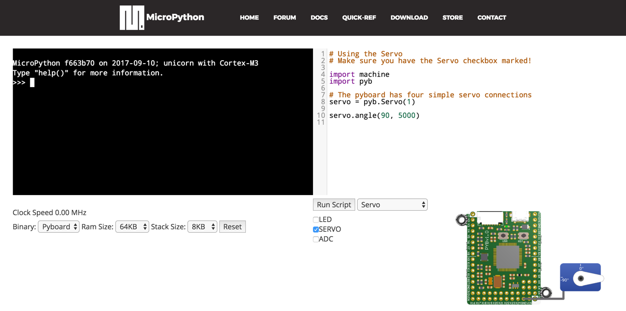
www.micropython.org/unicorn/

Slide 31
A Real-world problem
De-bouncing switches

Slide 32
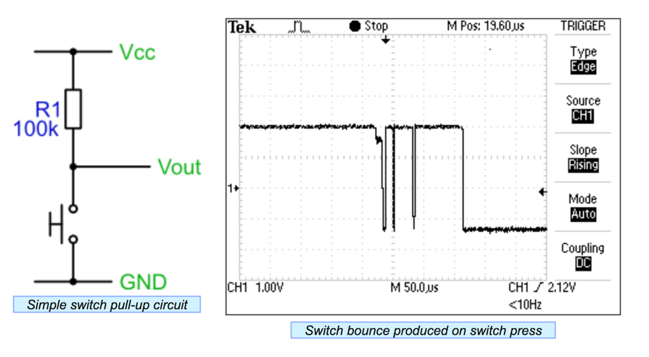
Switches Aren’t Just On/Off

Slide 33
Solving The Problem
Use a pure software solution
Sample at regular intervals
Switch is stable when N samples are the same

Slide 34
Switch Class Definition
from machine import Timer, Pin
class Switch:
def __init__(self, pin_no, name):
self._state = 0
self.value = 0
self.pin = Pin(pin_no)
self.name = name
def output(self):
"Return name of switch if closed, dot if open."
return self.name if self.value else "."

Slide 35
Debouncer Class Definition (1)
class Debouncer:
def __init__(self):
self.switches = []
self.timer = Timer(-1)
self.timer.init(period=6, mode=Timer.PERIODIC, callback=self.tick)
def register(self, switch):
"Add a switch to the bank."
self.switches.append(switch)
switch.pin.init(mode=Pin.IN, pull=Pin.PULL_UP)
return switch
6 ms intervals

Slide 36
Debouncer Class Definition (2)
def tick(self, _):
"Examine input states and note debounced state changes."
for switch in self.switches:
bit = switch.pin.value()
switch._state = ((switch._state << 1) | bit) & 0xfff
# Latch state if last 12 samples were equal
if switch._state == 0x000: # switch pressed
switch.value = True
elif switch._state == 0xfff: # switch released
switch.value = False

Slide 37
Switch Setup on ESP8266
def switches():
"Report names of closed switches."
return "".join(x.output() for x in (R, W, B, Y))
# Create a bank of four debounced switches
d = Debouncer()
Y = d.register(Switch(0, "Y")) # D3
R = d.register(Switch(14, "R")) # D5
W = d.register(Switch(12, "W")) # D6
B = d.register(Switch(13, "B")) # D7

Slide 38
Main Loop
# Background task loops reporting changes in any switch's state
state = switches()
while True:
new_state = switches()
if new_state != state:
state = new_state
print(state)

Slide 39
Installation (ESP8266 Systems)
wget http://micropython.org/resources/firmware/esp8266-20170823-v1.9.2.bin
pip install esptool
alias esptool="python -m esptool --port /dev/tty.wchusbserial1410"
esptool erase_flash
esptool --baud 115200 write_flash --flash_size=detect 0 \
esp8266-20170823-v1.9.2.bin

Slide 40

Live Demonstration!

Slide 41
Possibilities …
Robot control
Toys and games
Weather stations
Light patterns
Science instrumentation/data collection

Slide 42
Final Thoughts
Computers don’t just belong in mathematics
MicroPython gives children direct, hands-on experience
Puts them in control
The younger they start, the more useful they will find computers

Slide 43
Questions?
Contact me:
sh@felix.com
@holdenweb
Slides and code available at
http://github.com/holdenweb/PyConIE2017

Slide 44
More Resources
github.com/micropython/
github.com/micropython/micropython/wiki
www.micropython.org/download
twitter.com/search?q=#micropython

